Slide 1


Data Driven Storytelling Presentation:
Exploring Product Line Dynamics: Marketing Insights and Sales Trends Over 5 Years

Slide 2
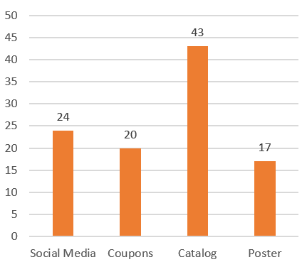
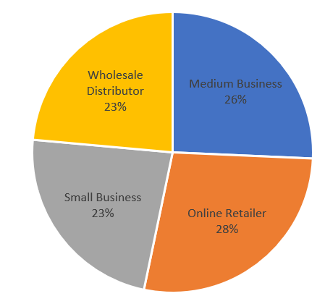
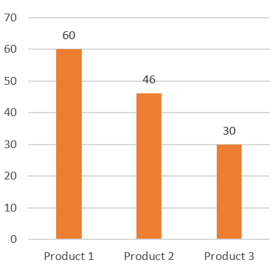
Promotion Campaigns, Product Lines and Account type A comprehensive study
Promotion Campaigns used by Account Types
Sale Volumes of Product 1 as per Account Type
Promotion Campaigns used by Account Types
Catalog Inclusion is the most widely used Promotion Campaign used by 86% of the total accounts (total 60 accounts).
Online Retailer has the highest profit from 2017-21 for Product 1. All account types share similar profits over 5 years.
Product 1 is sold by all 60 accounts, making it the most sold product line. Product 3 is only half of Product 1.

Slide 3
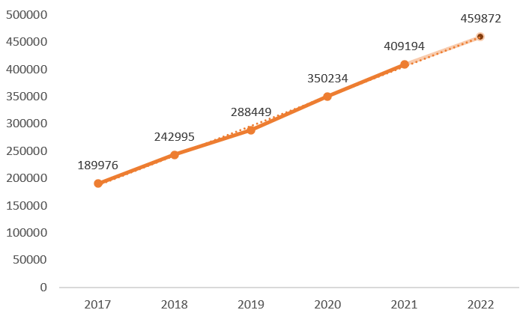
Trend over 2017-2021 Predicting for 2022
Prediction for 2022
Sales Volume of Product 1 follow an almost-perfect linear trend
Sales Volumes of Product 1 from 2017-21

Slide 4
Summary
For Product 1, accounts which used Catalog Inclusion for marketing received 135% more sales than accounts which did not. Every other marketing campaign has fewer sales when they are used that when they are not used.
Online Retailers is the most profitable account type by sales volumes of Product 1.
The highest CAGR, 335%, is recorded by “Small Businesses”. 11 out of 60 accounts have CAGR over 100%. “Medium Businesses” and “Online Retailers” each feature 4 accounts over 100% CAGR. “Small Businesses” is featured only once and “Wholesale Distributor” twice.
Sales volume data for Product 2 and 3 are not available, how factors are going to affect Product 2 and 3 cannot be determined.
More that 80% of the accounts with negative CAGR used none or just 1 marketing campaign. This shows the significance which ads play in sales.
To maintain sales, marketing campaigns should be utilized by focusing more on Catalog Inclusion. Other campaign types need to be enhanced to draw more sales.
Closing poorly performing accounts, with negative CAGR, is highly recommended.

